Slide 1


Online Passive-Aggressive Algorithms
Shai Shalev-Shwartz joint work with
Koby Crammer, Ofer Dekel & Yoram Singer
The Hebrew University
Jerusalem, Israel

Slide 2



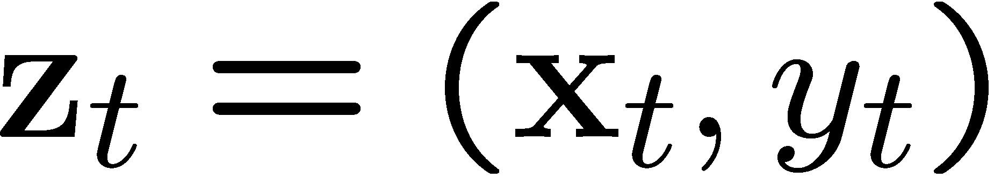

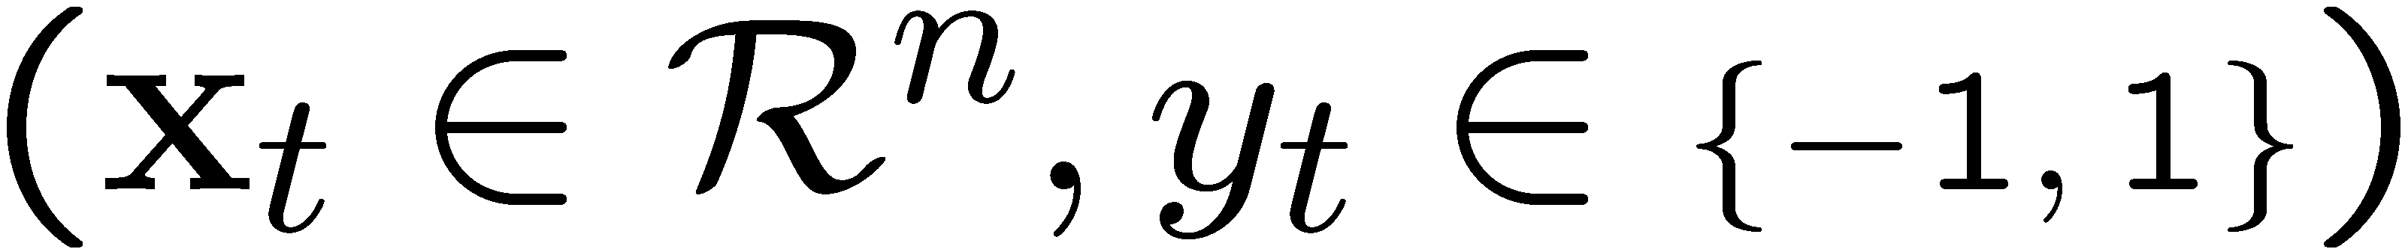
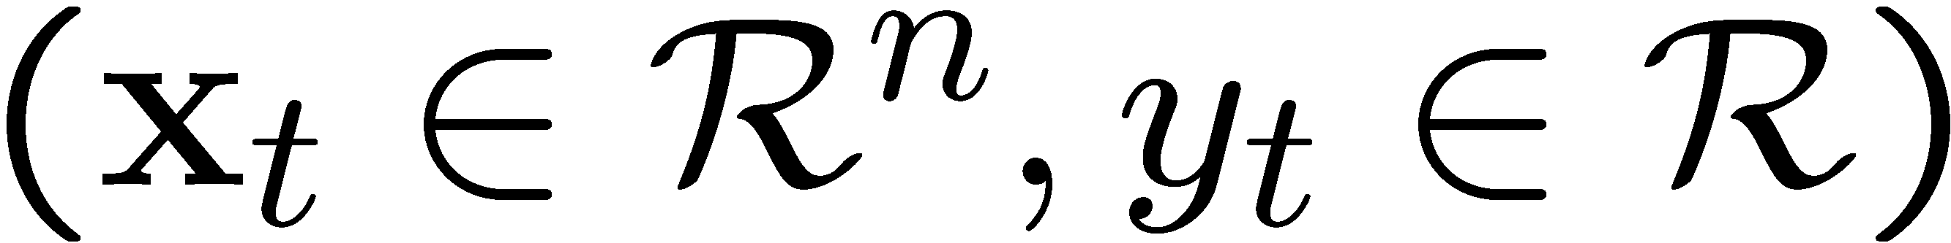
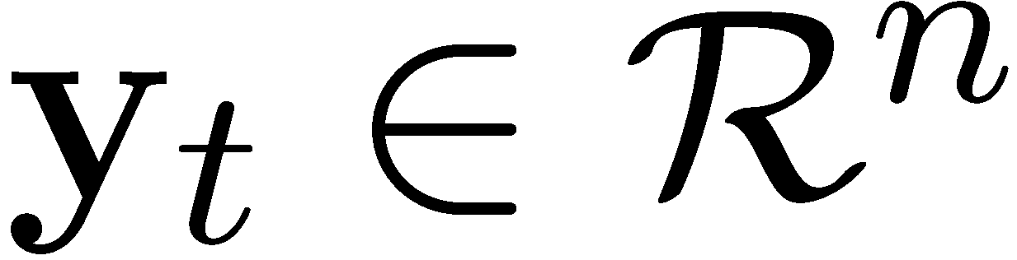
Three Decision Problems
Classification
Regression
Uniclass
Notes:
We consider 3 decision problems. The first is “Classification” in which we have instances in R^n and labels. The goal is to find a hyperplane that separates the positive instances from the negative instances, that is, we would like that y_t w \cdot x_t will have a large positive value. By “large” we mean at least \epsilon. We denote the instance-label pair by z.
In Regression the instances are again in R^n. However, the targets are real numbers and the goal is to predict the true target y_t using the linear function
w \cdot x_t. Here \epsilon measures the accuracy of our prediction.
Finally, in uniclass the targets are vectors in R^n. “w” is our prediction and \epsilon is again an accuracy parameter.

Slide 3
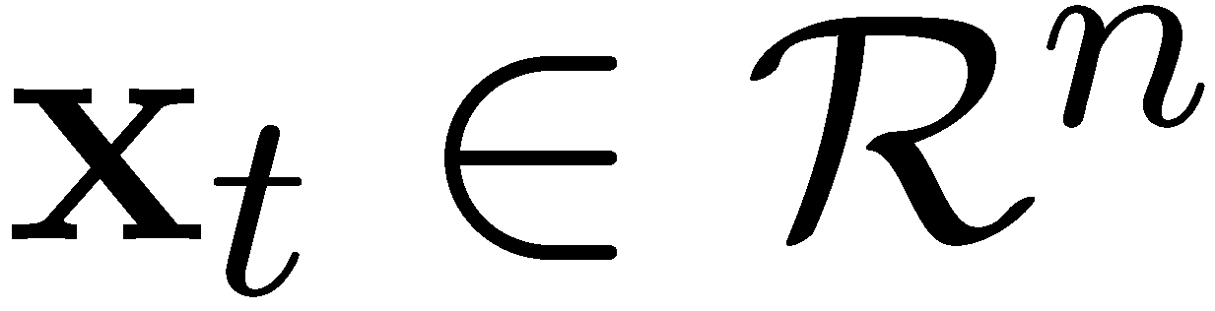
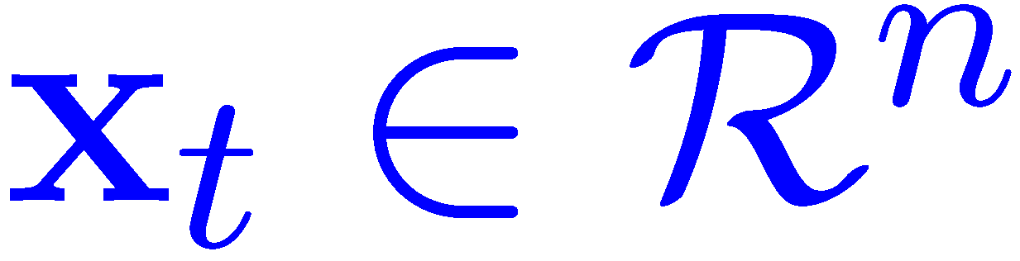
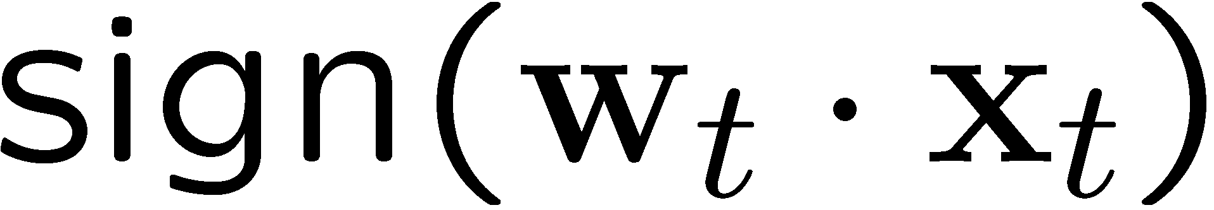



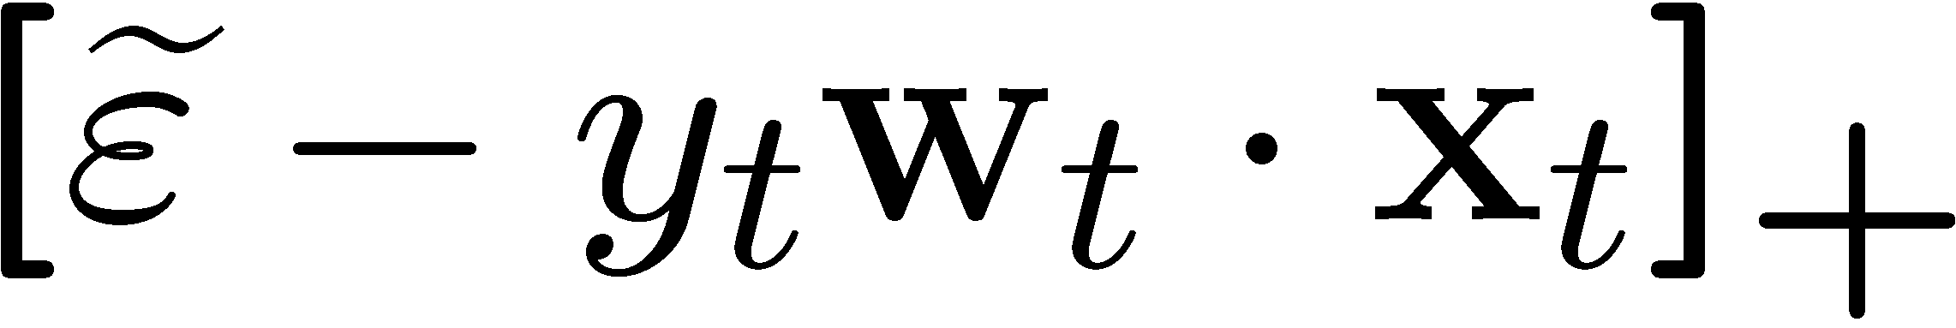
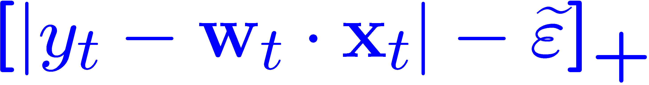

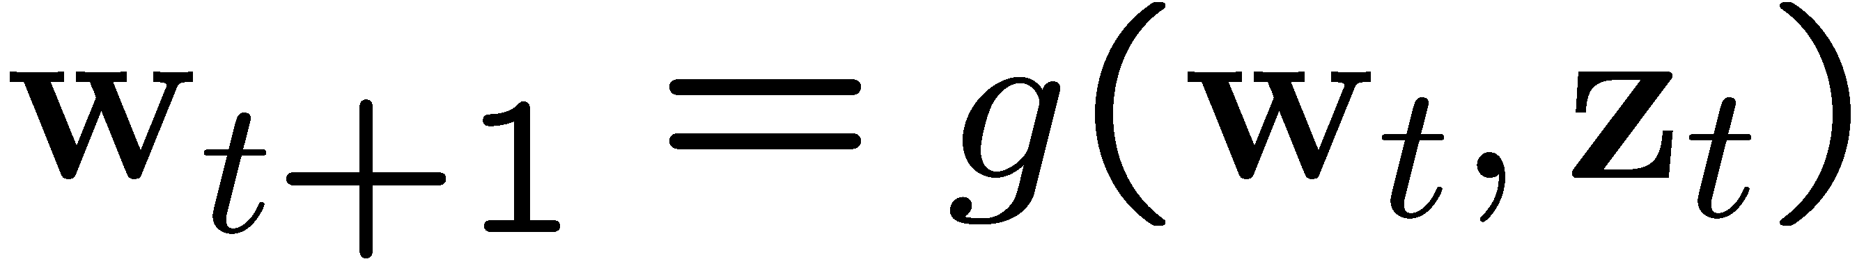
Online Setting
Classification
Regression
Uniclass
Receive instance
  n/a
Predict target value
Receive true target ; suffer loss
Update hypothesis
Notes:
We consider the Online setting, that is we receive examples in a sequential manner. For simplicity, let me start with the case of classification.
On each round we receive an instance x_t and extend a prediction using our current hypothesis w_t.
We then receive the true target y_t and suffer an instantaneous loss based on the discrepancy between y_t and our prediction.
Our goal is to make the cumulative loss that we suffer small.
Finally, we update the hypothesis according to the previous hypothesis and the current example.
The setting for regression and uniclass is similar.
In Regression, we predict a real value target w_t \dot x_t and then suffer loss according to the discrepancy between our prediction and the true one.
In Uniclass, the setting is slightly different as we do not have instances. Instead, we extend a center point w_t and hope that y_t falls within a radius of \epsilon from w_t. We again suffer loss according to the actual distance between y_t and the center w_t.

Slide 4



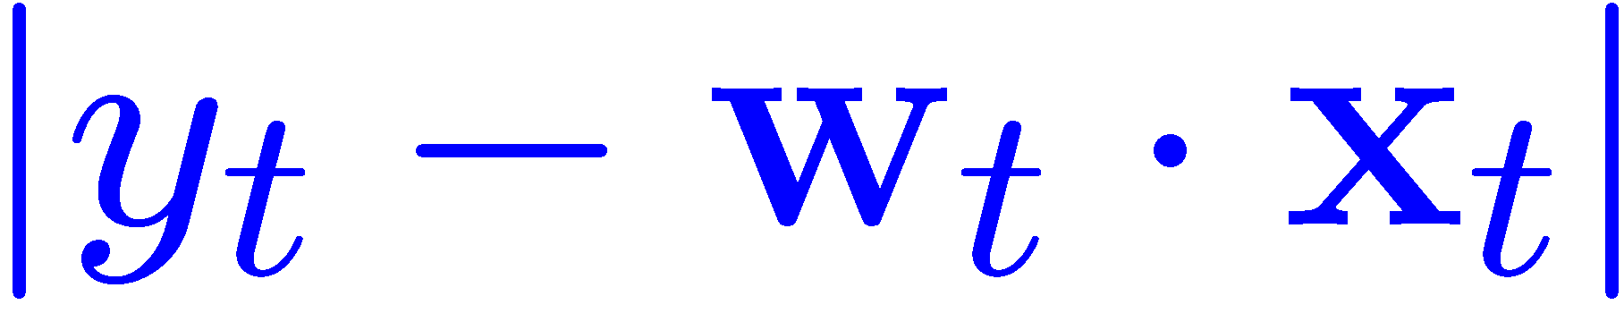

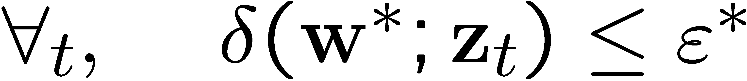
A Unified View
Classification
Regression
Uniclass
Define discrepancy for :
Unified Hinge-Loss:
Notion of Realizability:
Notes:
The three problems described above can be viewed as a private case of the following general framework. The end result is a common algorithmic framework and an accompanying analysis.
We denote the discrepancy of a hypothesis w according to example \z_t by \delta. For classification, \delta is the negation of the signed margin, and for regression and classification \delta is the distance between our prediction and the true target.
We start with algorithm and analysis for the realizable case – that is we assume that there exist w star and epsilon star such that …
We define the hinge-loss to be the maximum between delta minus epsilon and zero. Say in other words, we pay linearly on the violation of the constraint: delta less or equal to epsilon.

Slide 5
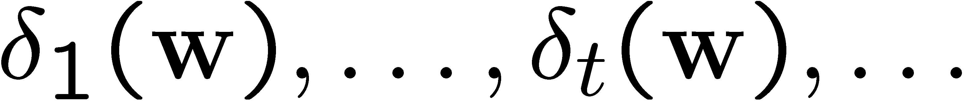
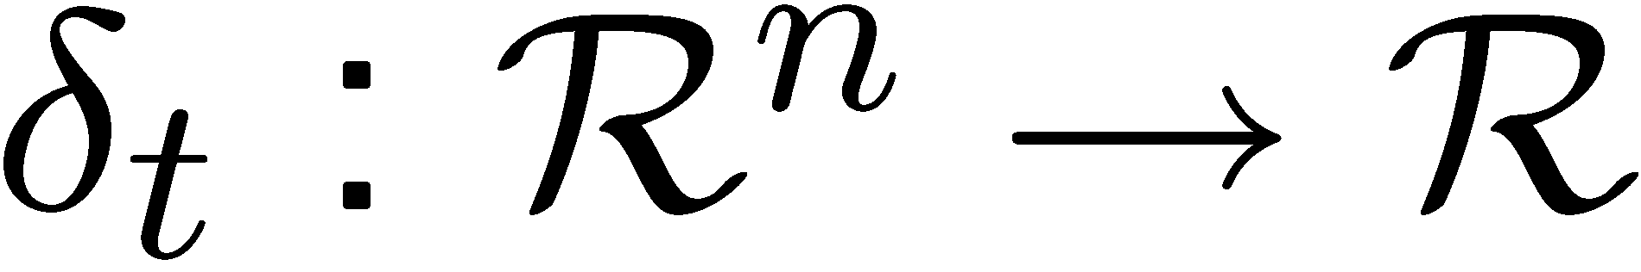

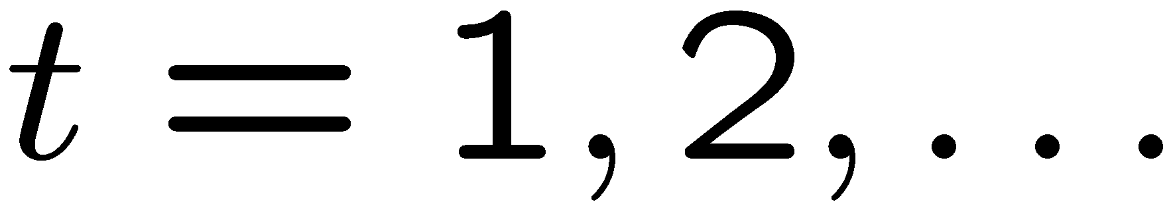
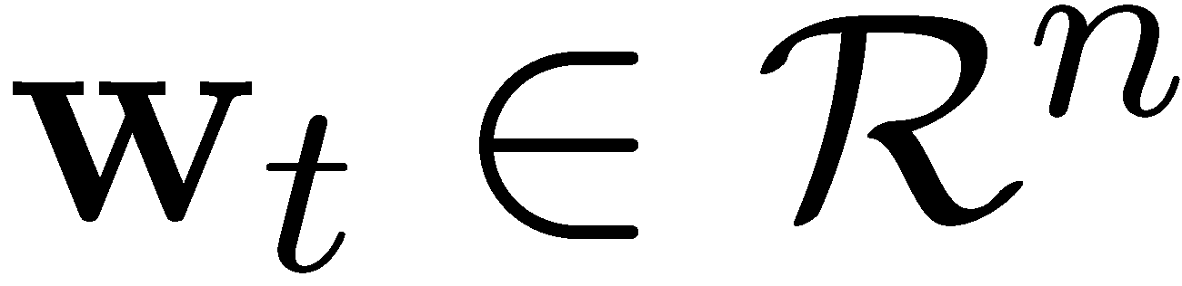
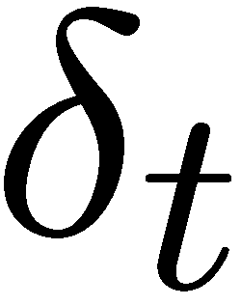
A Unified View (Cont.)
Online Convex Programming:
  Let be a sequence of convex functions:
  Let be an insensitivity parameter.
  For
    Guess a vector
    Get the current convex function
    Suffer loss
  Goal: minimize the cumulative loss

Slide 6
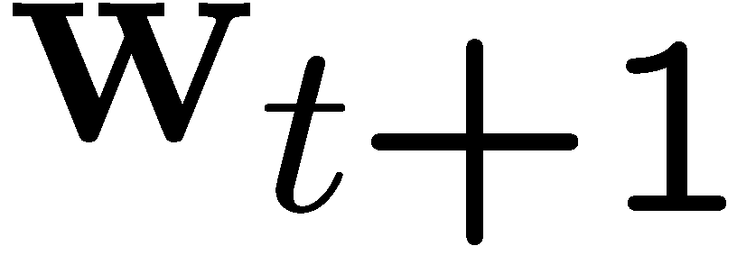

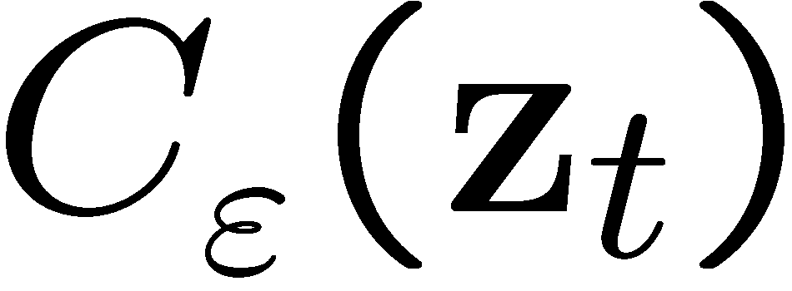
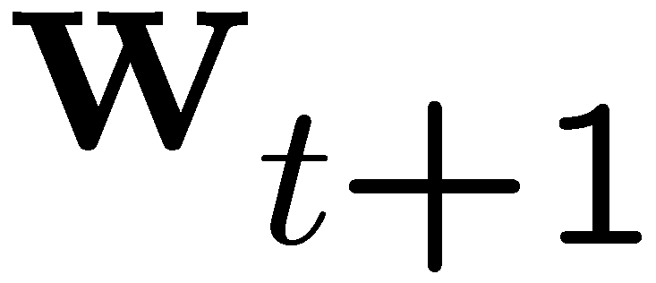

The Passive-Aggressive Algorithm
Each example defines a set of consistent hypotheses:
The new vector is set to be the projection of onto
Classification
Regression
Uniclass
Notes:
Equipped with the above unified view, we now turn to the algorithm.
Each new example the set of all hypotheses that attains zero loss on the example.
For classification, C is half space. For regression, C is a hyperslab and for uniclass C is a ball centered at y_t.
We think of C as an instantaneous version space.
Since delta is a convex function, C is a convex set.
Our update function is setting the new vector (w t plus 1) to be the projection of w_t onto the instantaneous version space. That is w (t plus 1) is a vector in C which is closest to the previous weight vector.
Intuitively, we attempt to make w_{t+1} be as close to w_t as possible while forcing w_{t+1} to achieve zero loss on the most recent example.

Slide 7

Passive-Aggressive

Slide 8
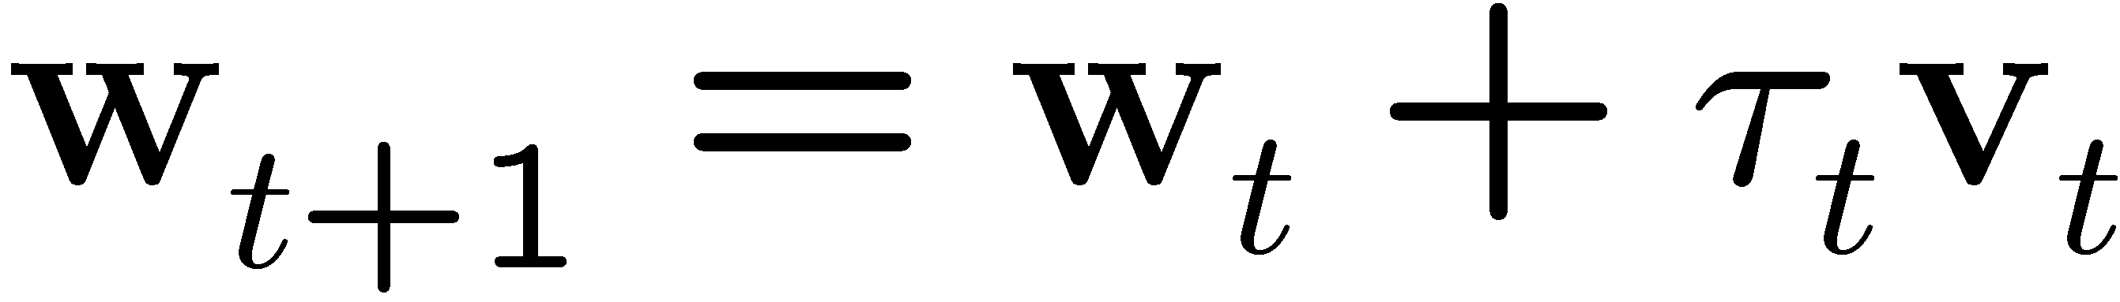
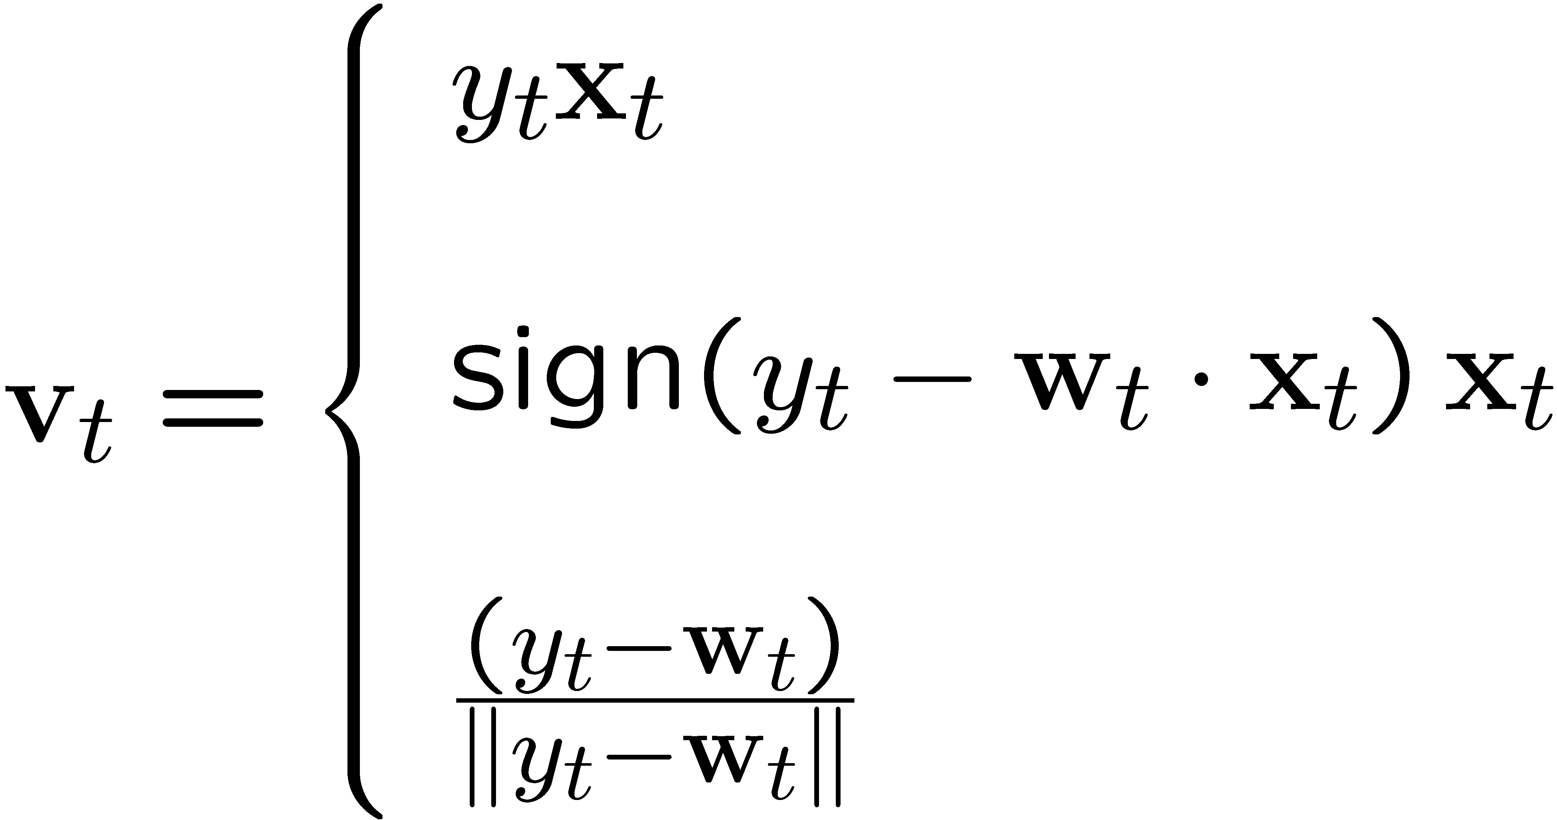
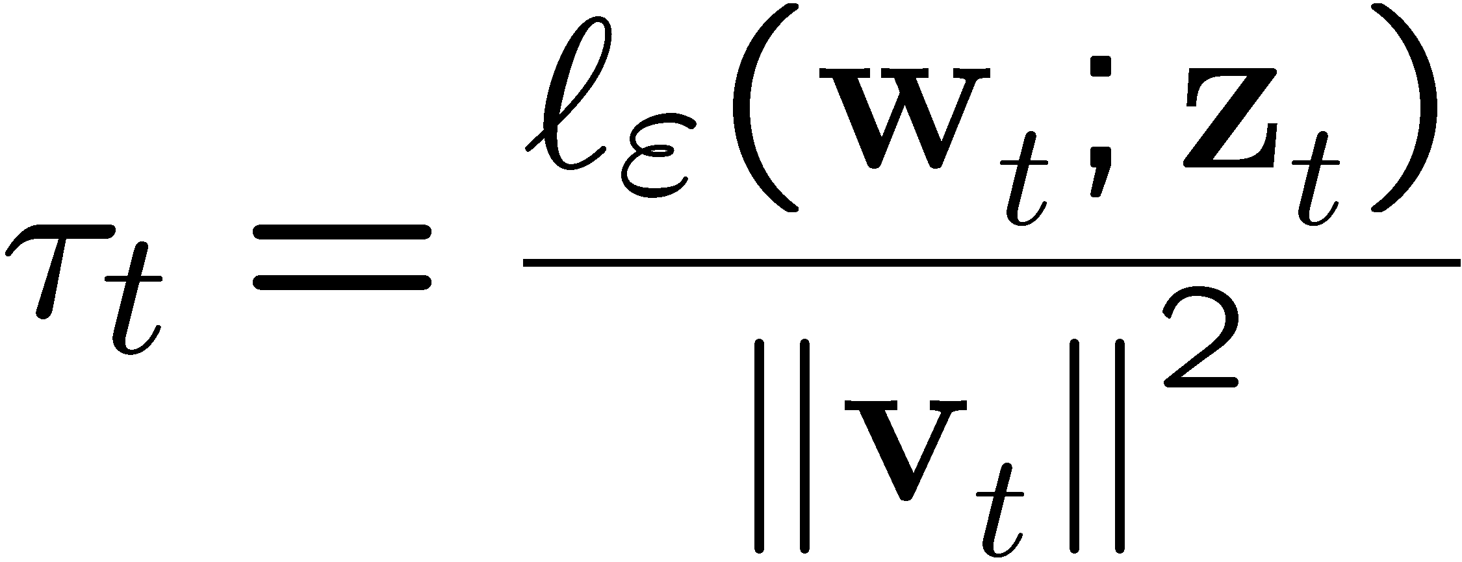
An Analytic Solution
Classification
where
Regression
Uniclass
and

Slide 9
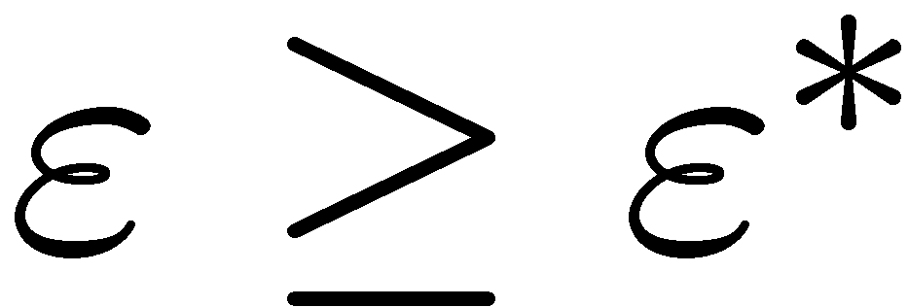

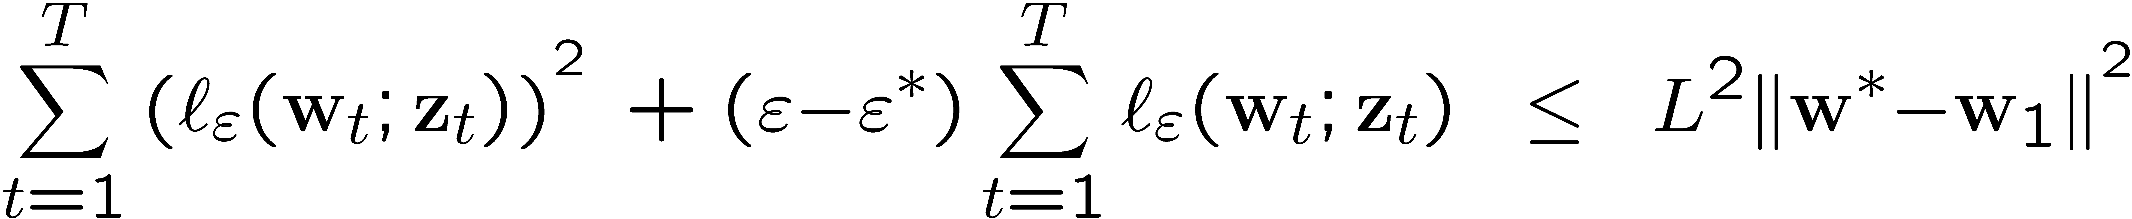
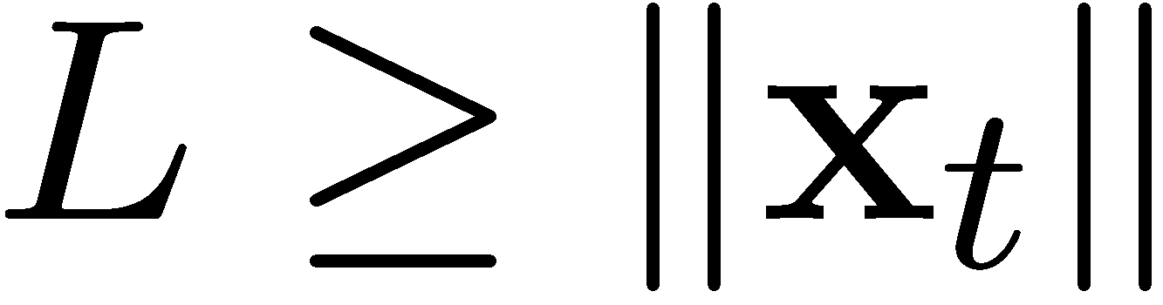

Loss Bounds
Theorem:
  - a sequence of examples.
  Assumption:
  Then if the online algorithm is run with , the following bound holds for any
  where for classification and regression
  and for uniclass.

Slide 10
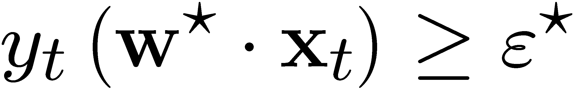
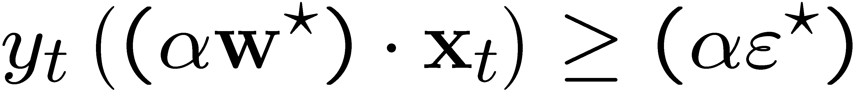


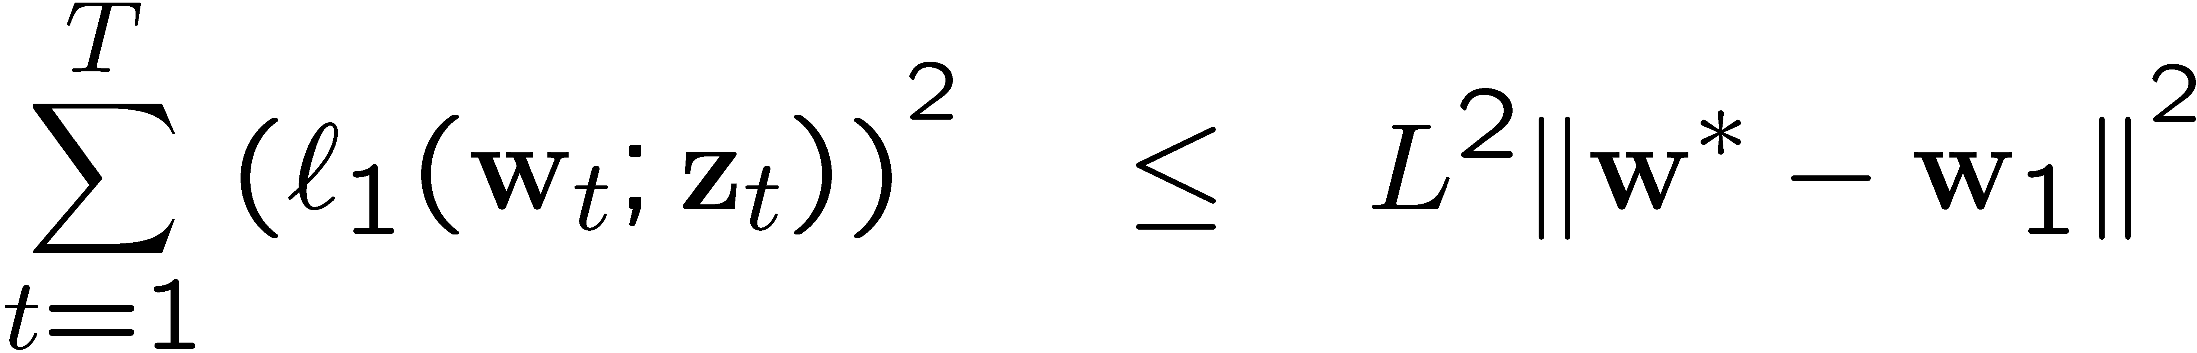
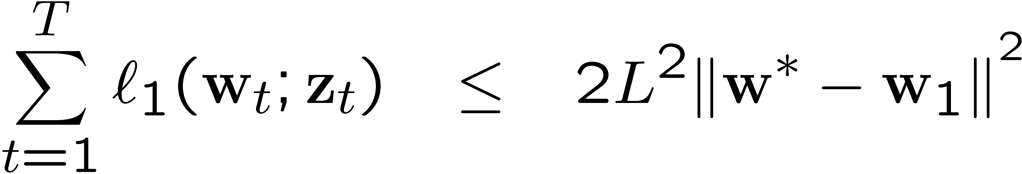
Loss bounds (cont.)
For the case of classification we have one degree of freedom since if then for any
Therefore, we can set and get the following bounds:

Slide 11
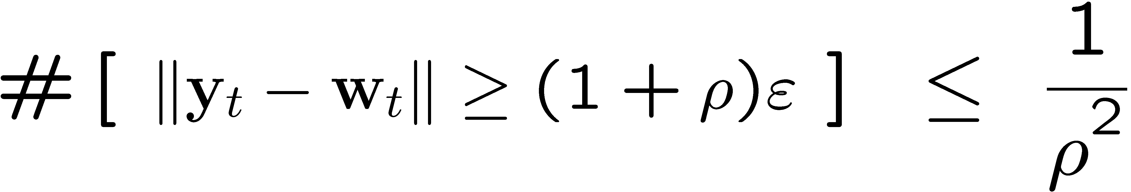
Loss bounds (Cont).
Classification
Uniclass

Slide 12
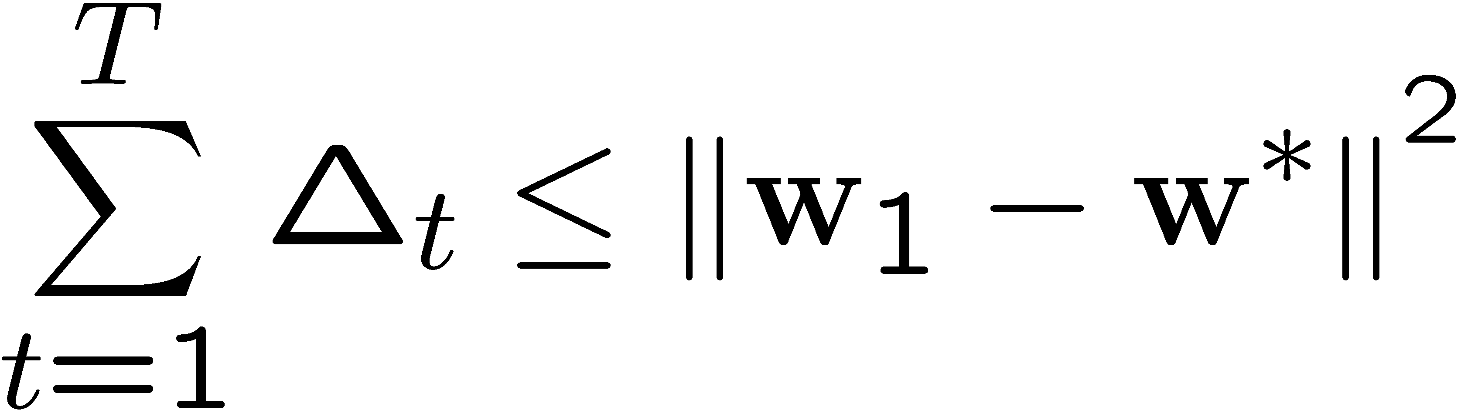
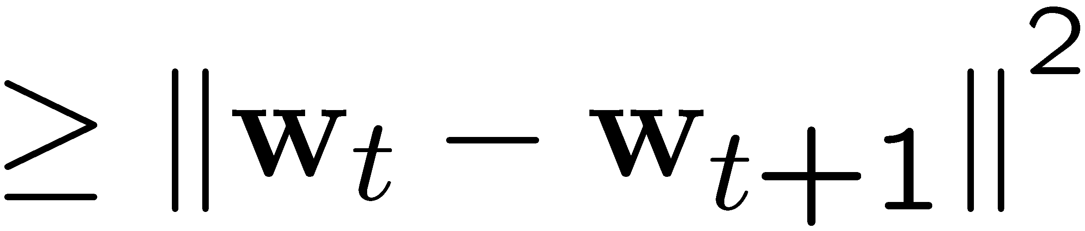
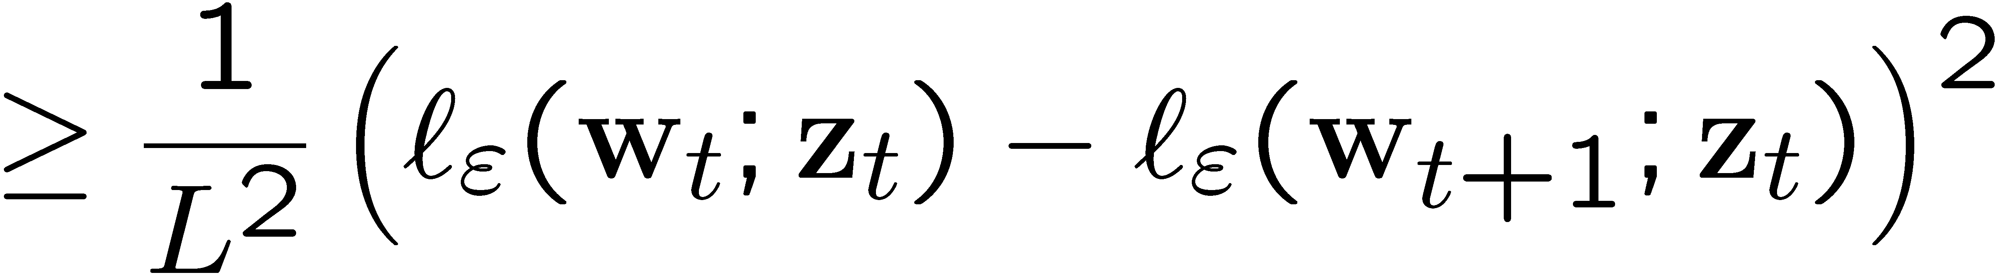


Proof Sketch
Define:
Upper bound:
Lower bound:
Lipschitz Condition

Slide 13
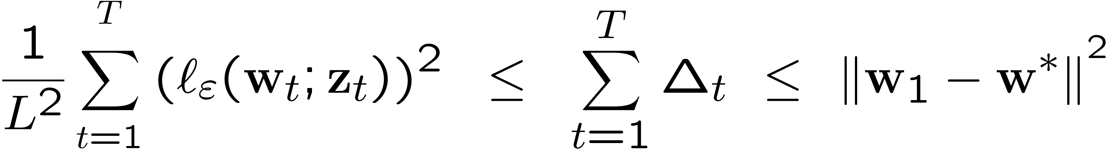
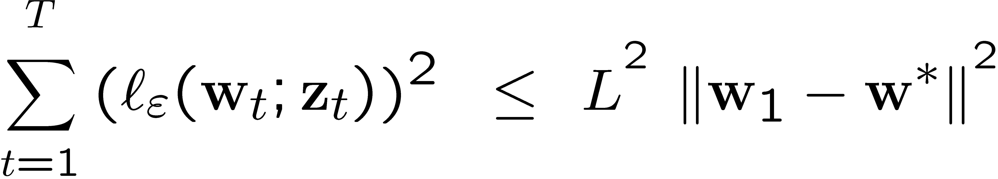
Proof Sketch (Cont.)
Combining upper and lower bounds

Slide 14

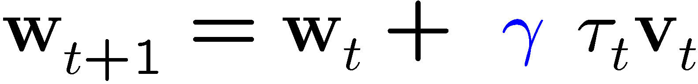


The Unrealizable Case
Main idea: downsize step size by
Notes:
We’re not so aggressive.

Slide 15


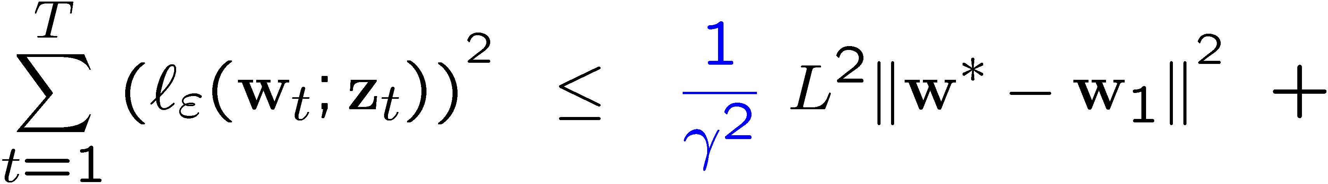
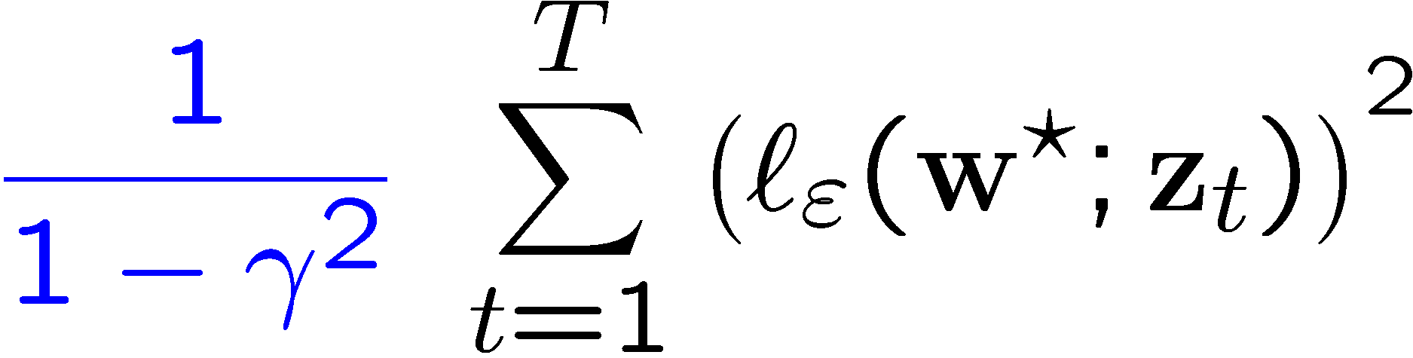
Loss Bound
Theorem:
  - sequence of examples.
  bound for any and for any

Slide 16
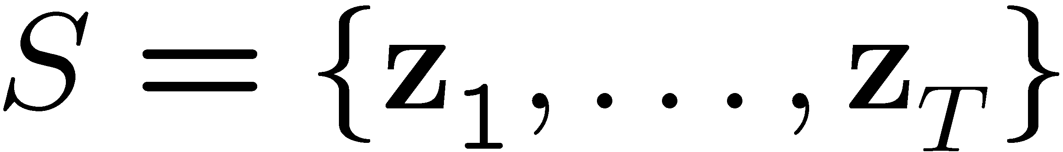
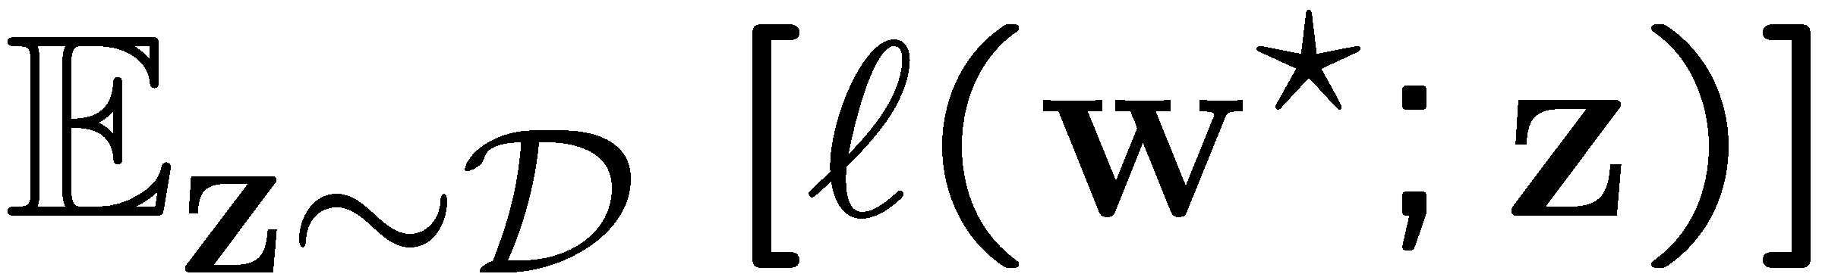
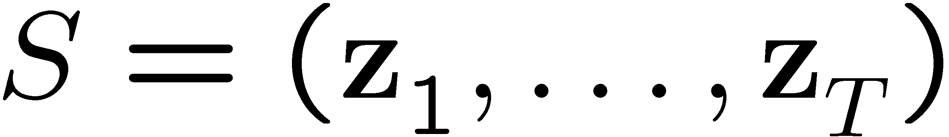
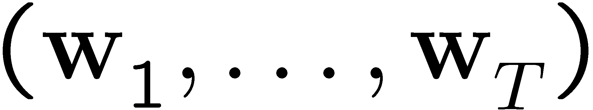
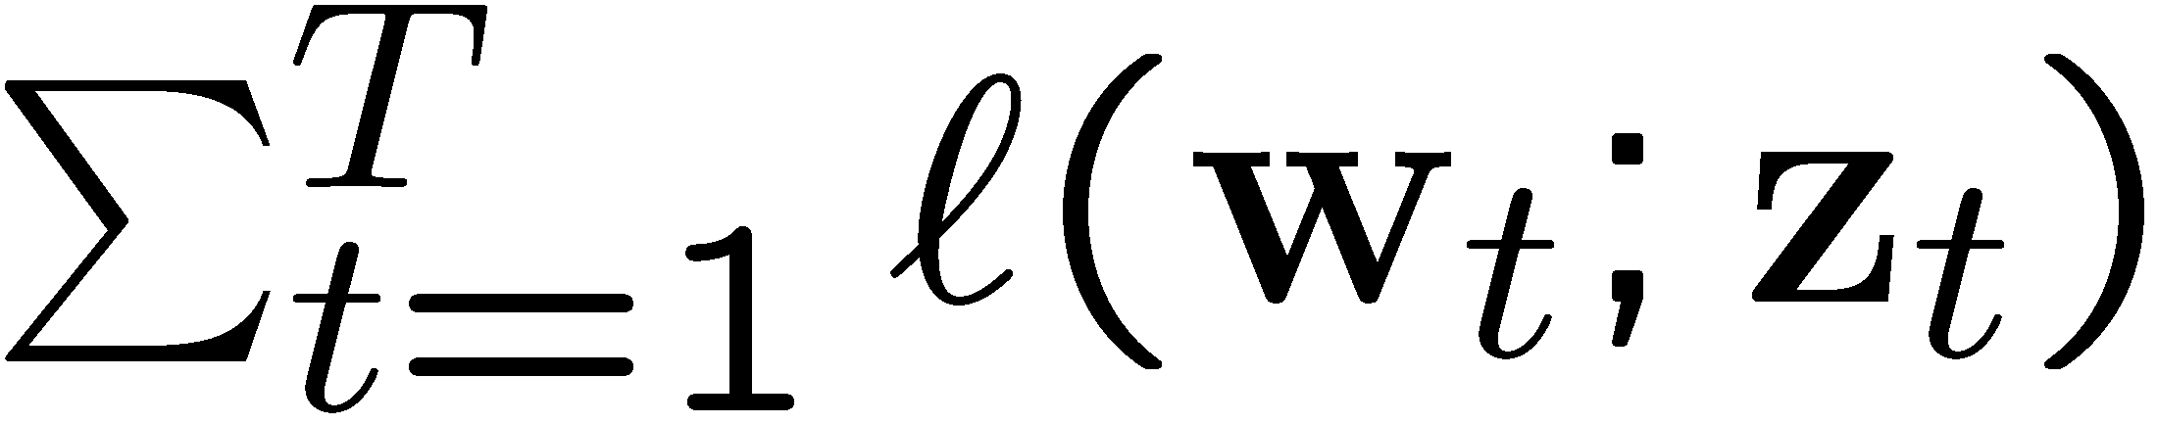
Implications for Batch Learning
Batch Setting:
  Input: A training set , sampled i.i.d according to an unknown distribution D.
  Output: A hypothesis parameterized by
  Goal: Minimize
Online Setting:
  Input: A sequence of examples
  Output: A sequence of hypotheses
  Goal: Minimize

Slide 17
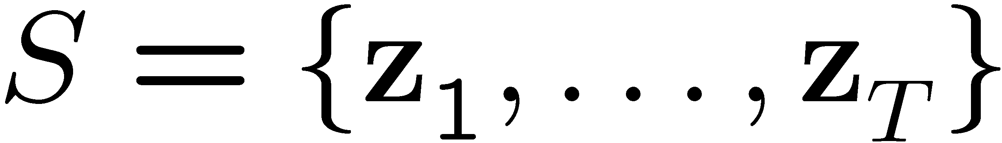


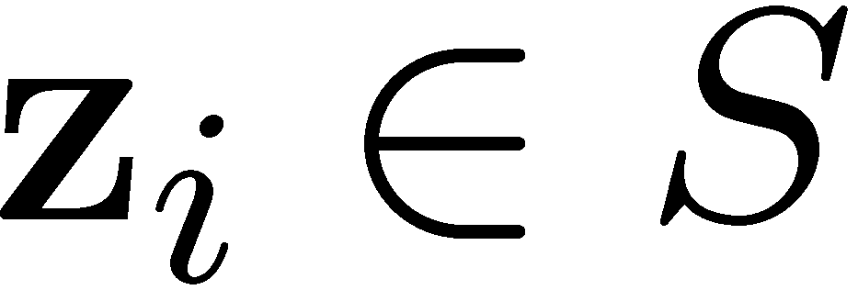
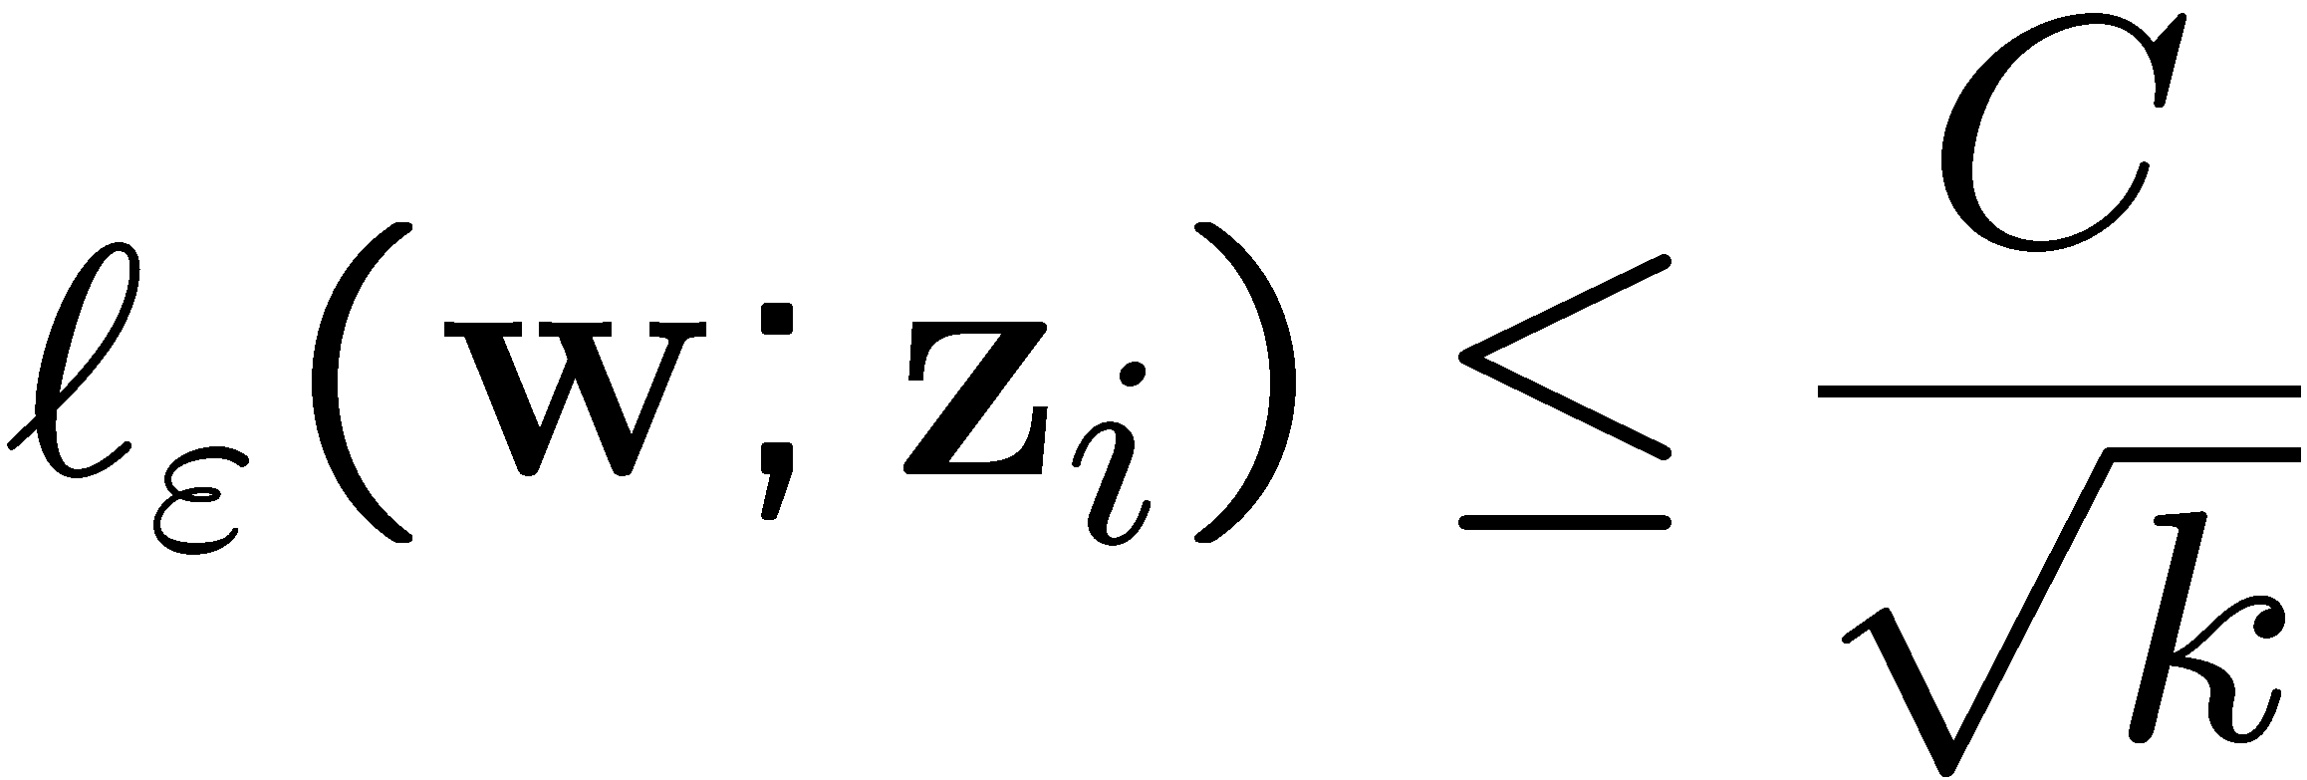


Implications for Batch Learning (Cont.)
Convergence:
Let be a fixed training set and let be the vector obtained by PA after epochs. Then, for any
Large margin for classification:
For all we have: ,
which implies that the margin attained by PA for classification is at least half the optimal margin
Notes:
Square root.

Slide 18
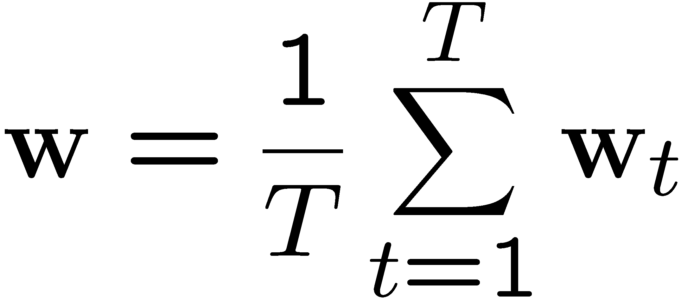
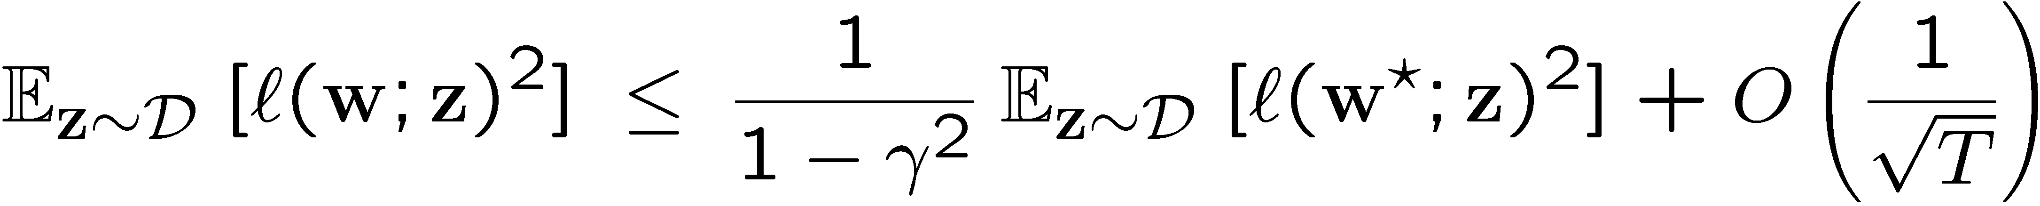
Derived Generalization Properties
Average hypothesis:
Let be the average hypothesis. Then, with high probability we have

Slide 19
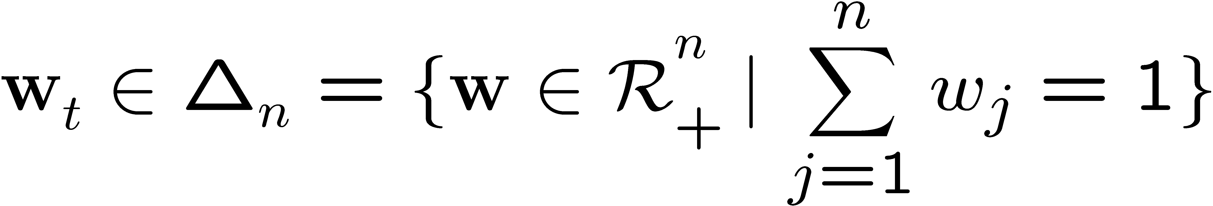

A Multiplicative Version
Assumption:
Multiplicative update:
Loss bound:

Slide 20
Summary
Unified view of three decision problems
New algorithms for prediction with hinge loss
Competitive loss bounds for hinge loss
Unrealizable Case: Algorithms & Analysis
Multiplicative Algorithms
Batch Learning Implications
Future Work & Extensions:
Updates using general Bregman projections
Applications of PA to other decision problems

Slide 21
Related Work
Projections Onto Convex Sets (POCS), e.g.:
  Y. Censor and S.A. Zenios, “Parallel Optimization”
  H.H. Bauschke and J.M. Borwein, “On Projection Algorithms for Solving Convex Feasibility Problems”
Online Learning, e.g.:
  M. Herbster, “Learning additive models online with fast evaluating kernels”

